Slide 1
Finance Aggregator Data Scenario
Designed by Cambell Craigie Github link: Cambell32/Aggregator_data_scenario

Slide 2
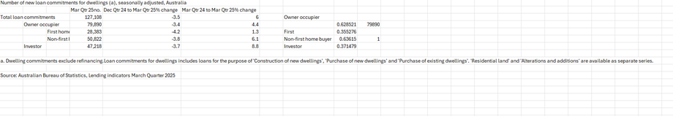
Introduction to the scenario and its purpose
The data scenario imagines a data analyst utilizing an entire data pipeline in a finance aggregator company, from marketing and product management to ROI and customer segmentations.
This data scenario was inspired by data from the ABS (Australian Bureau of Statistics, Lending indicators March Quarter 2025).

Slide 3
General note on constraints and limitations
That said, broader lending environmental conditions were not considered, as the data scenario is intended to be very general in its approach.
It illustrates a data pipeline environment that a data analyst could be expected to operate within to resolve stakeholder queries from across a finance aggregator’s business.
In this instance, the scenario is concerned with resolving questions regarding data relating to customers, loans, lenders, and brokers.
All information presented in the data scenario was inferred and doesn’t reflect total market conditions, standards, or requirements. It is for demonstrative purposes only and should not be taken as advice, financial or other.

Slide 4
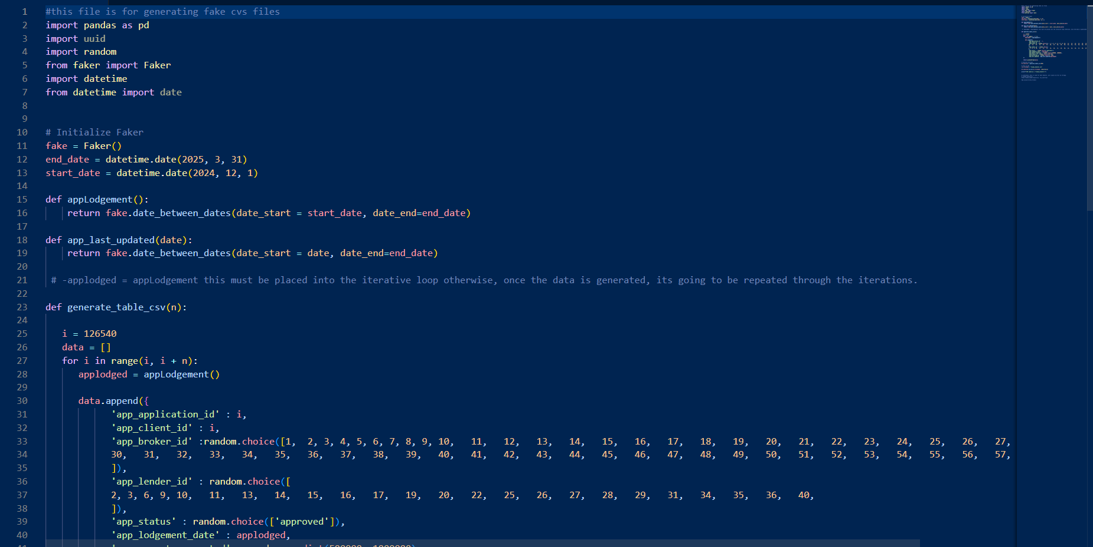
The problem and the approach
The problem: a business development manager has requested a quarterly report regarding the finance aggregators’ performance ahead of a meeting with lenders and brokers.
The approach made some statistical assumptions based on the original ABS data in Excel.
Then Python and its libraries, faker, random and pandas, were used to generate and handle the faux data before it was entered into a MYSQL database.
It was then extracted, formatted in Python into CSV files, before being accessed in Power BI.
This broad generalist approach has reflected the design assumption that solving any business problem requires adaptability and flexibility.

Slide 5
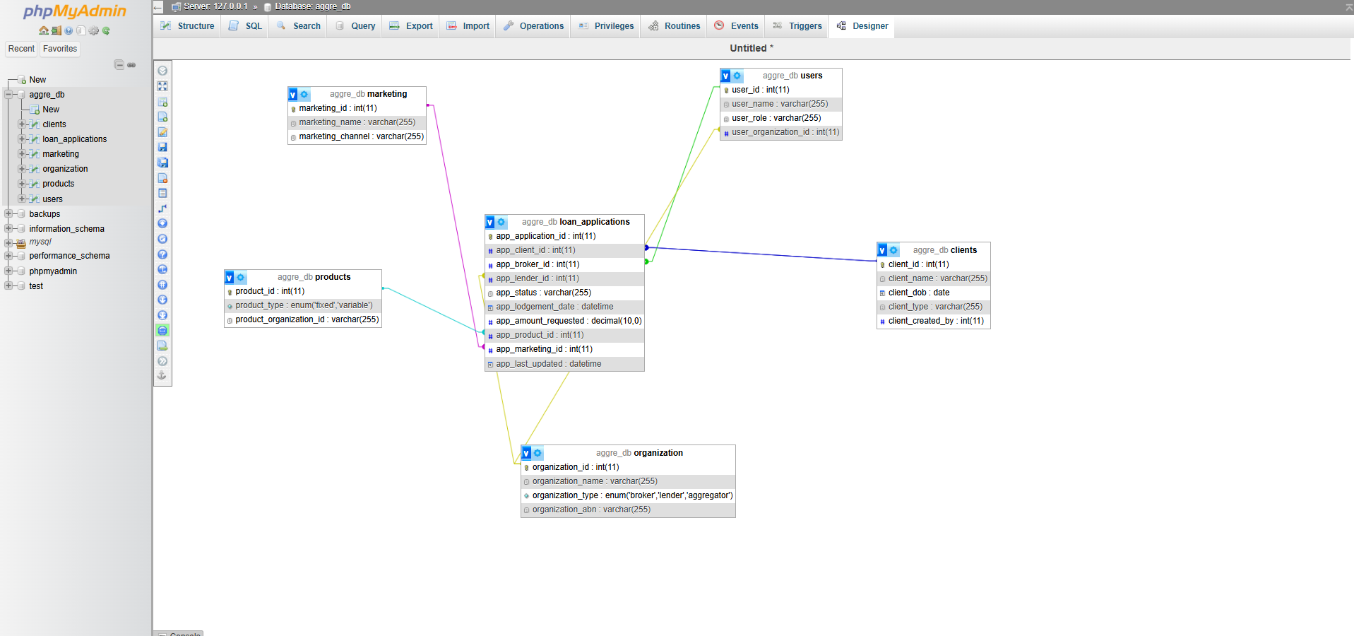
MYSQL finance aggregator schema

Slide 6
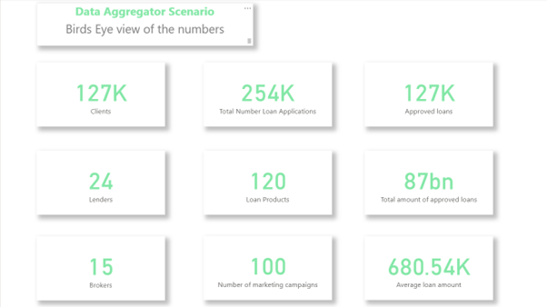
Birds Eye view of performance
Total applications submitted for the quarter were taken to be 252,692. This includes approved loans as well as inferred rejected and dropped loans.
Of the total submitted, 127,000 clients in the aggregator’s network accounted for the 127,000 approved loans, from a rounded total of 254,000 loan submissions.
It was found that the non-first-home-buyer client type was the majority of approved loans, with approximately 51,000. Followed by investors with 47,218, and lastly, first-home buyers at 28,000.

Slide 7
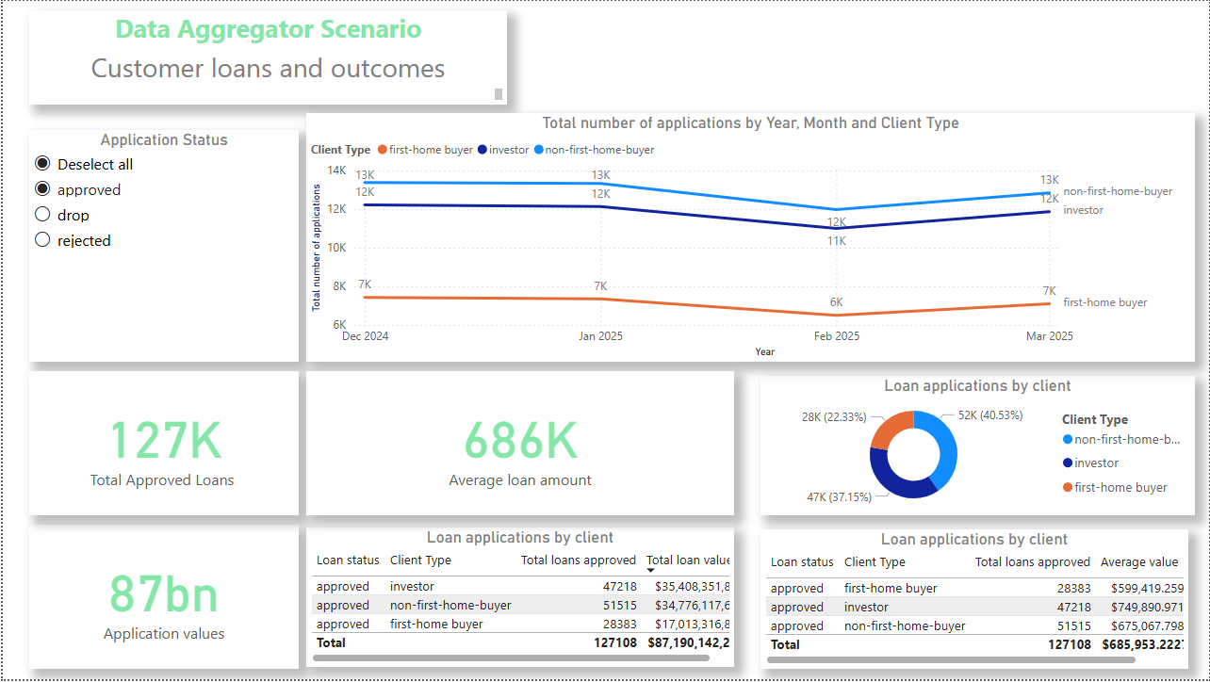
Customer loan data
As a segment, investors have been shown as the most valuable by total approved loan applications in the aggregator’s data, at 35 billion dollars.
The average loan amount was 686,000, but averaging loans by customer segment showed that the investor segment was most valuable at 749,890.
There is a notable difference between first-home buyers and the other client types in both the total loan values and the total loans submitted and approved.
What was a factor that impacted all client types though, was the date.
Trends indicate a notable drop in approved loans during February, indicating a dampening of submission numbers in December 2024 before they picked up again by March 2025.
This would indicate a return to BAU following the holiday period.
This trend was not client-specific, with all client type submission numbers reflecting the same trend in the aggregator data.

Slide 8
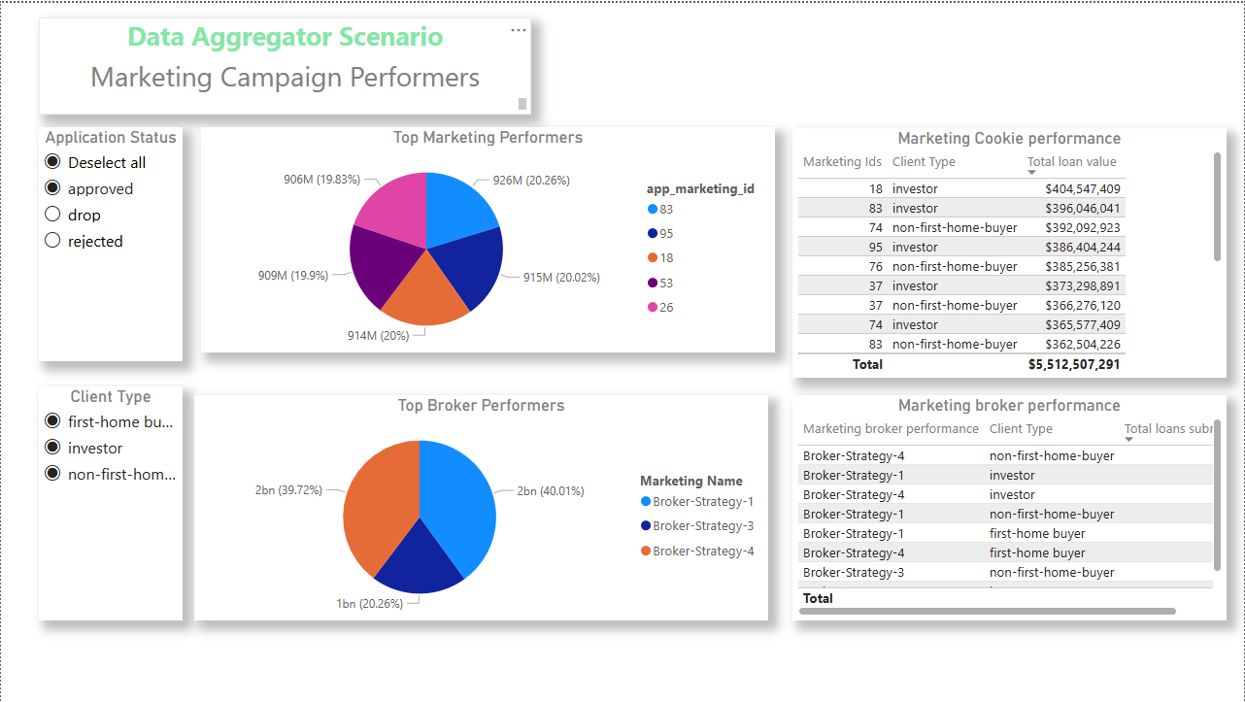
Marketing Data
Marketing performance is reflected in marketing IDs, to track where the aggregator was marketing.
Broker strategies reflect the effectiveness of the aggregator’s platform for its brokerage partners.
During this quarter, the aggregator’s most effective strategy would appear to be Marketing ID 83.
The single best-performing, by total approved loans, was marketing ID 18 with 404 million, with the investor client type.

Slide 9
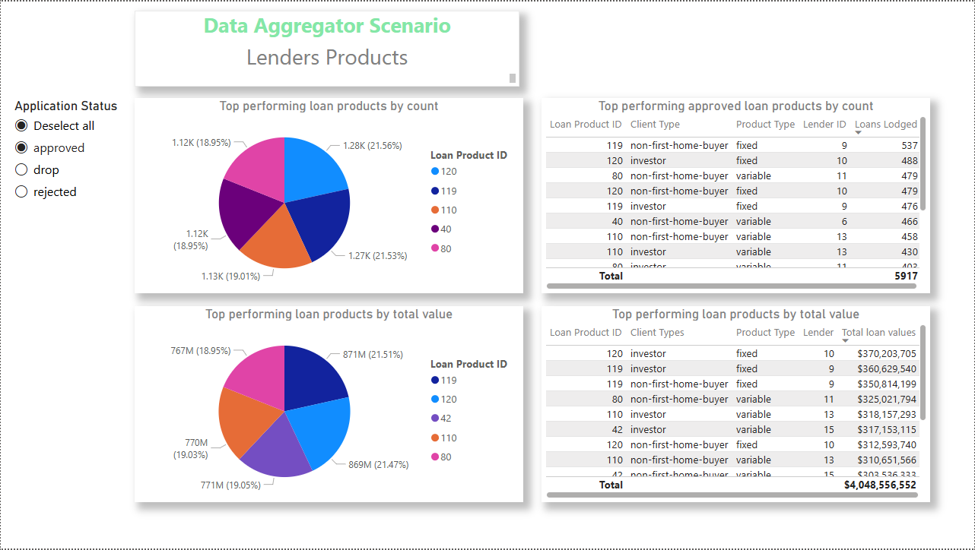
Lenders and products
There is a very close margin between the top 5 loan products by submission approval and the client type. Interestingly, this reflects the trend seen in the marketing campaigns. Again, non-first-home buyers comprise 3 of the top 5 positions and investors the other 2.
Tellingly, first-home buyers, by approved submissions or total value by loan product, don’t crack the top 10 of loan products.
Regarding the loan product rate types, the approved total loan submissions and values were dominated by the fixed loan types.
That said, these comprised a much smaller margin of all loan products and so should be discarded for greater accuracy of customer preferences overall.
Meaning, variable rates still make the greatest proportion by submission and value totals.
Undoubtedly, this anticipates customer sentiments around future rate cuts being likely.

Slide 10
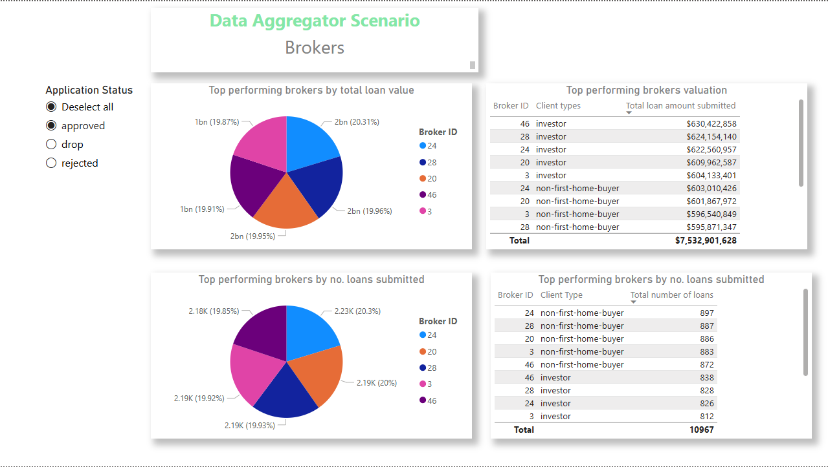
Brokers
We can see immediately the inversion between the total value of approved loans and the total number of approved loans submitted.
In this instance, Broker 46 performed the best singularly, and their client type investor clientele came in at a rounded 630 million.
By loans, Broker 24 did the best by total approved loans at 897.
As shown across every facet of the finance aggregator’s data, from marketing to brokers, the two primary client types are investor and non-first-home buyer, who took out the top 10 positions across all the data points.

Slide 11
Results
At first glance, the data from the Power BI report is insightful in providing a 10,000ft view and snapshot of how a financial aggregator may have their database and ETL processes set up.
The division across the multiple parts of the business that handle and interact with customers, from the marketing, loans, and lenders, is pertinent in deriving marketing insights and effectiveness by the finance aggregator.
That said, the next important step could be for the finance aggregator in the scenario to investigate if there was anything in the marketing campaigns that was effective in engaging and assisting lenders and brokers in reaching customers.
For example, lack of engagement by client type with platforms could be one explanation or the general market conditions, such as first home buyers and 5% deposits.
Downstream from that, recommendations to brokers and tying them to lenders and products that could help them craft a more compelling value proposition in the market may be the best way forward for the finance aggregator to retain and deliver value within its network.
Technically, the client types reflect the ABS data source, with one notable point being that the most approved client submitted loans were the non-first home buyers, which reflects the original ABS data that the data scenario was created from.

Slide 12
References
All information presented in the data scenario was inferred and doesn’t reflect total market conditions, standards, or requirements. It is for demonstrative purposes only. Lending indicators March Quarter 2025
Australian Bureau of Statistics https://www.abs.gov.au/statistics/economy/finance/lending-indicators/mar-quarter-2025
What is the average new mortgage in Australia?
Canstar https://www.canstar.com.au/home-loans/average-home-loan-australia/

